Slide 1

Ethereum
Fraud Detection
Arjun Chanda| Jai Agrawal | Ambika Mudigonda | Qiuhan Li | Sahithi Muddana

Slide 2
Contents
Introduction to Ethereum
How Ethereum works?
Ethereum vs. Bitcoin
Fraud in cryptocurrency
Exploratory Data Analysis
Model Results
Findings

Slide 3

Introduction to Ethereum
Founded by Vitalik Buterin (Co-Founder of Bitcoin Magazine)
Proposed in late 2013 and released in 2014
2nd largest Cryptocurrency
It is a platform, NOT a currency
The currency is called Ether
Notes:
DIY platform for Decentralised Apps (DApps)
Infrastructure for running DApps worldwide

Slide 4

Ethereum Transaction
Bus → Block
Kids → Transactions
Ethereum capacity → 500 txn per block

Slide 5
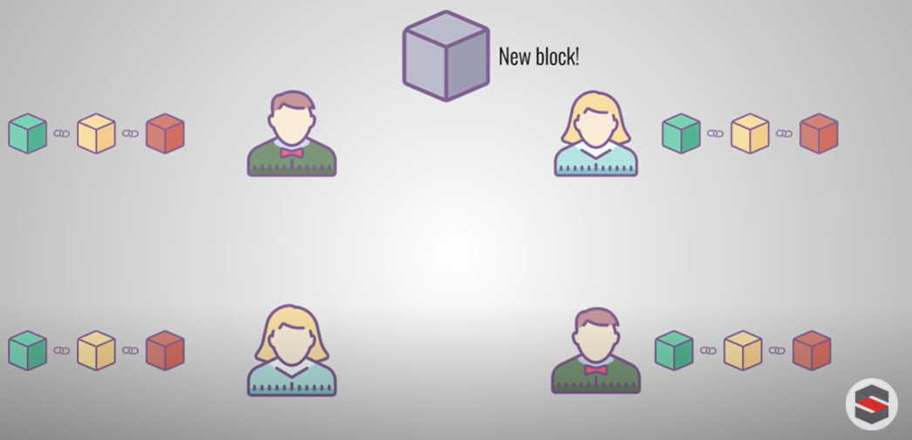
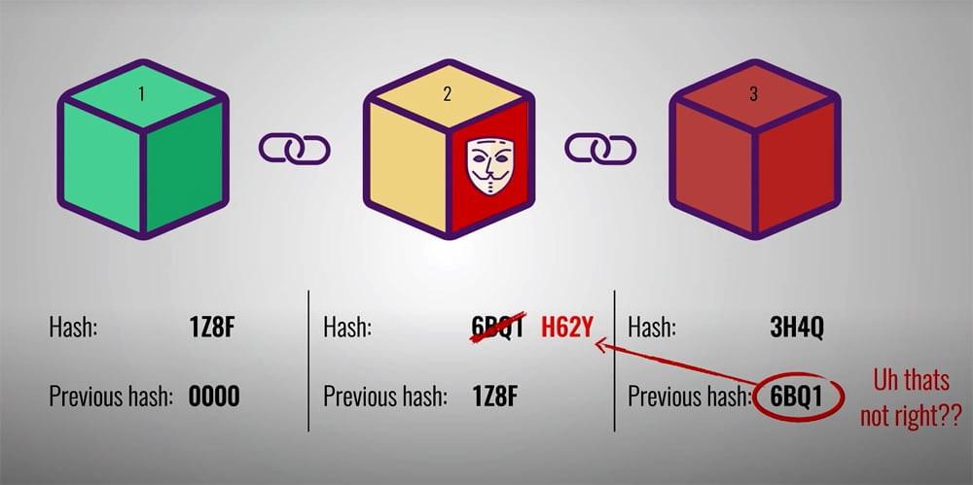
Fraud in Cryptocurrencies
1
Miners using Transaction fee (Gas in Gwei)
2
Contracts using Honeypots
Notes:
Developer - (code in Solidity) compiler - convert to white code
Ether is dollar, Gwei is cents

Slide 6
Data
51
9841
variables
remove
17
records
variables & NAs
Variables : 34
Valid : 7,662 records
Fraudulent : 2,179 records

Slide 7
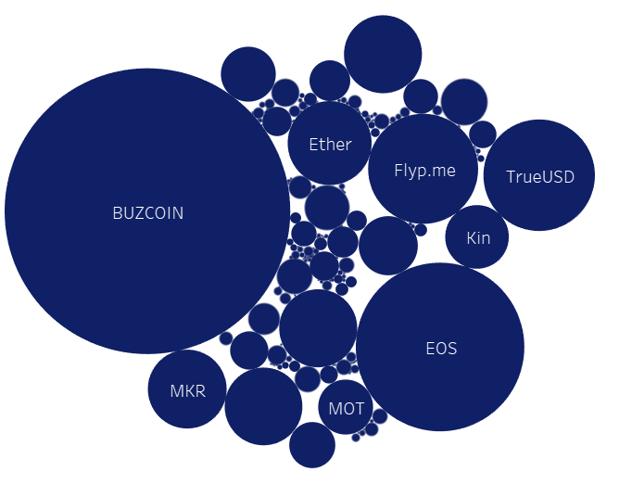
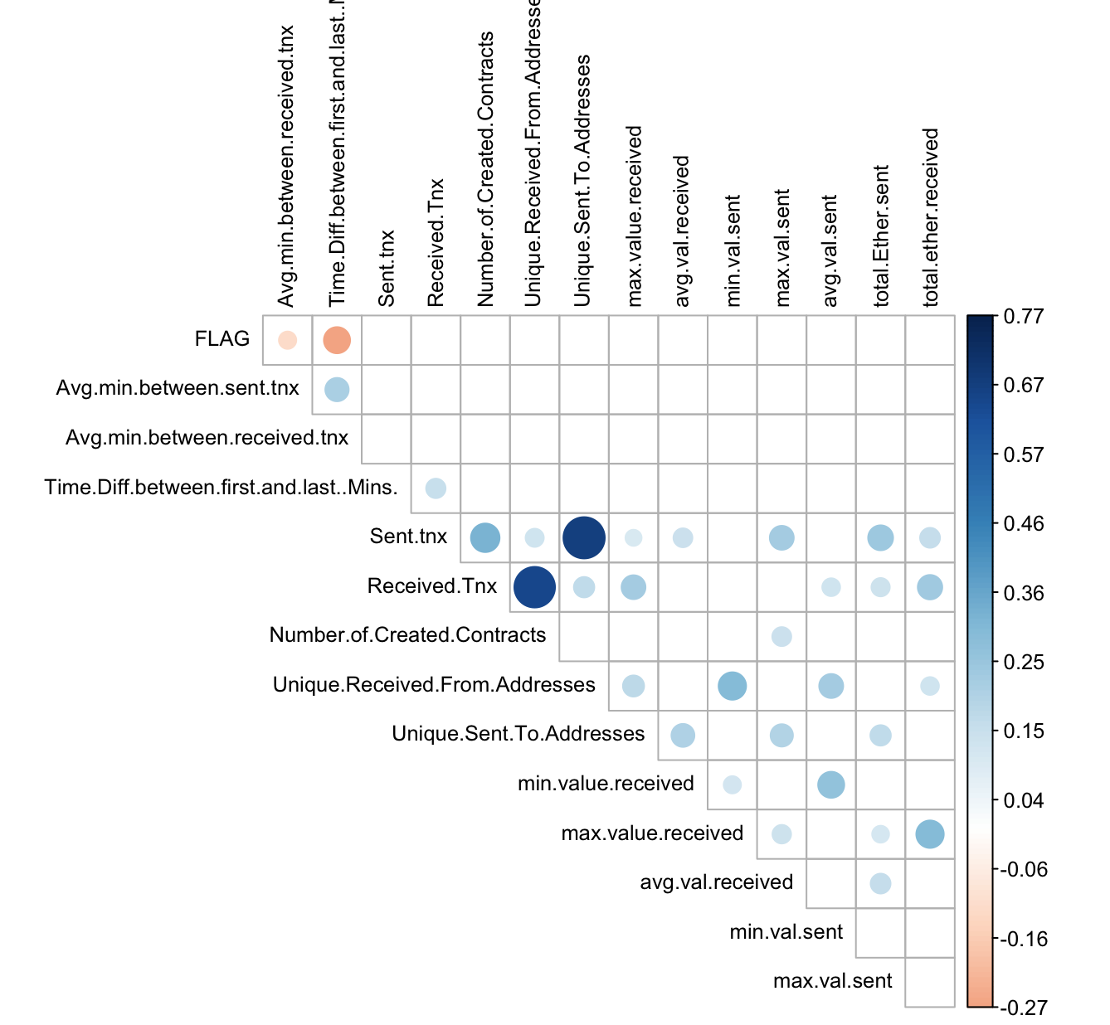
Exploration
Most used Token
Correlation Matrix

Slide 8
Model Results
 | Logistic Regression | Naive Bayes | KNN | Decision Tree | Random Forest
Accuracy | 83.19% | 56.74% | 84.15% | 92.74% | 96.22%
Precision | 87.71% | 82.27% | 86.07% | 95.29% | 96.02%
Recall | 77.19% | 17.19% | 81.48% | 89.93% | 96.44%

Slide 9
Findings
KEY VARIABLES
INSIGHTS
Time between Transactions
Value of Ether received
Total number of token transactions
Shorter time difference between transactions
Lower value Ether transaction
Less transactions
⇒ HIGHER CHANCE OF FRAUD

Slide 10

THANK YOU

Slide 11
APPENDIX
2. Models used
Logistic Regression
Naive Bayes
KNN
Decision Tree
Random Forest
Preprocessing
Libraries
Cleaning
Balancing Data

Slide 12
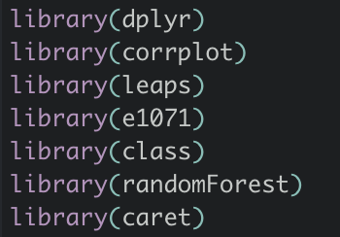
Libraries
dplyr
corrplot
leaps
e1071
class
randomForest
caret
tree

Slide 13
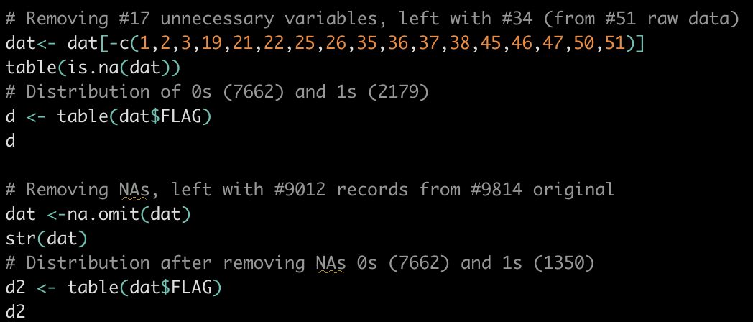
Cleaning
Removing NA variables
Removing unnecessary variables (ex. Address)
Removing highly correlated variables
Remaining 34 variables 9012 observations

Slide 14
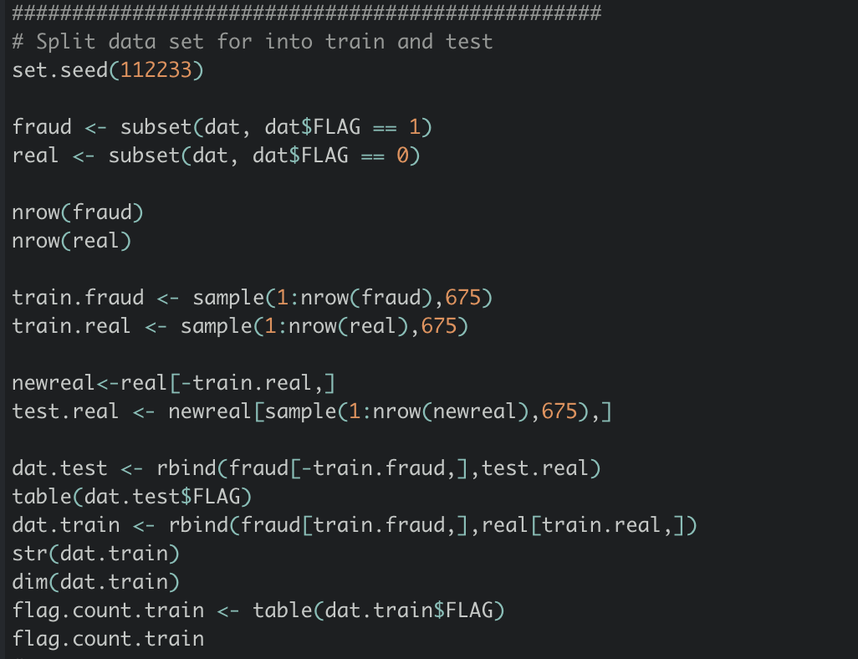
Balancing Data
Since our dataset was imbalanced (in favor or real transactions), we made the test train split contain the same amount of real and fraud data so that our models could not get high accuracy just by predicting all outcomes to be real
Train size: 1350 (equal 0s,1s)
Test size: 1350 (equal 0s,1s)

Slide 15
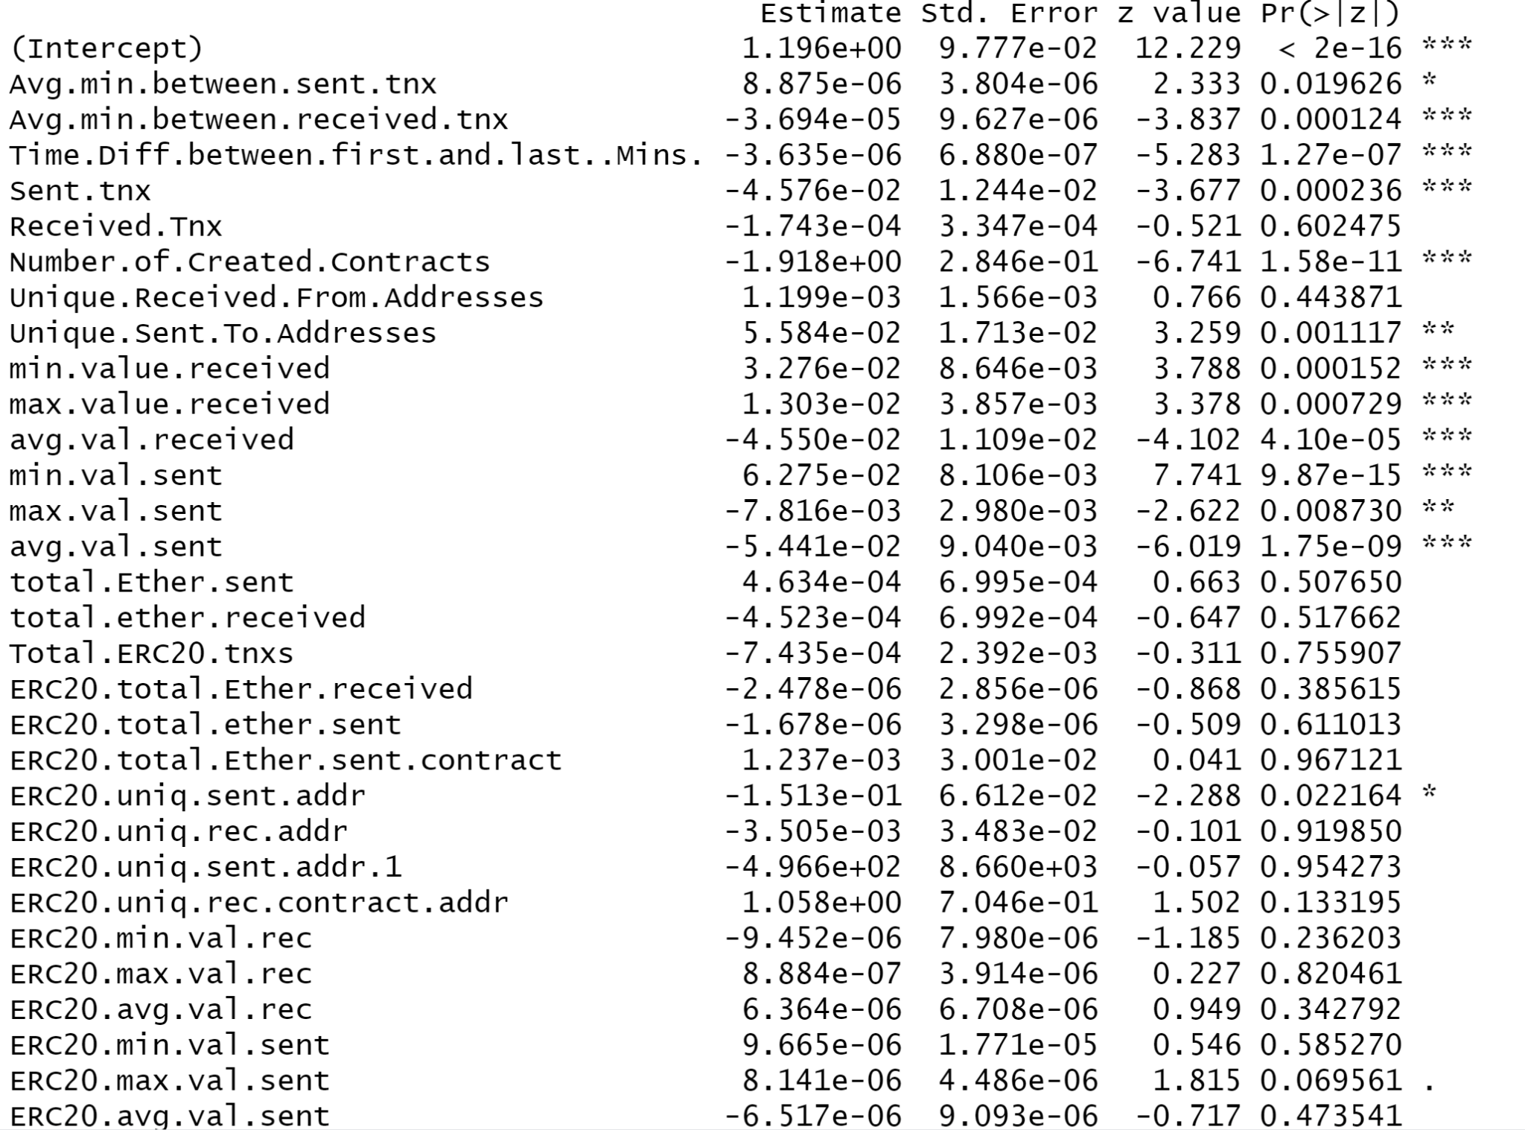
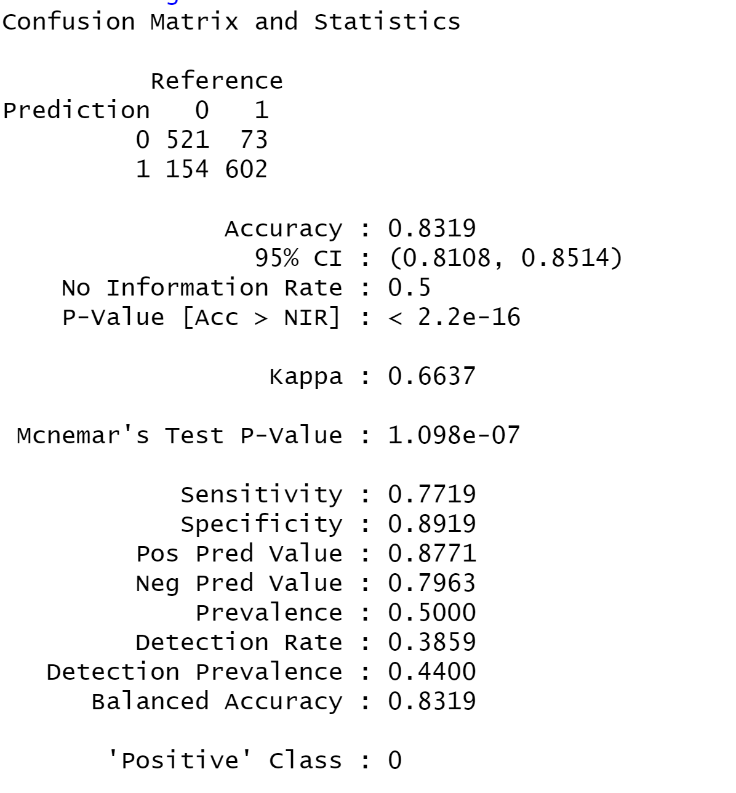
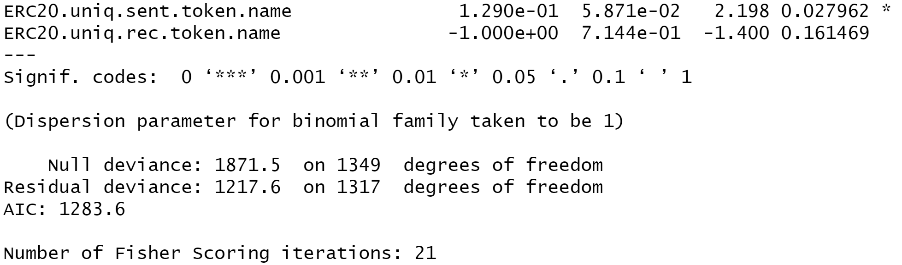
Logistic Regression
16 significant variables
Accuracy = 83.19%
Precision = 87.71%
Recall = 77.19%

Slide 16
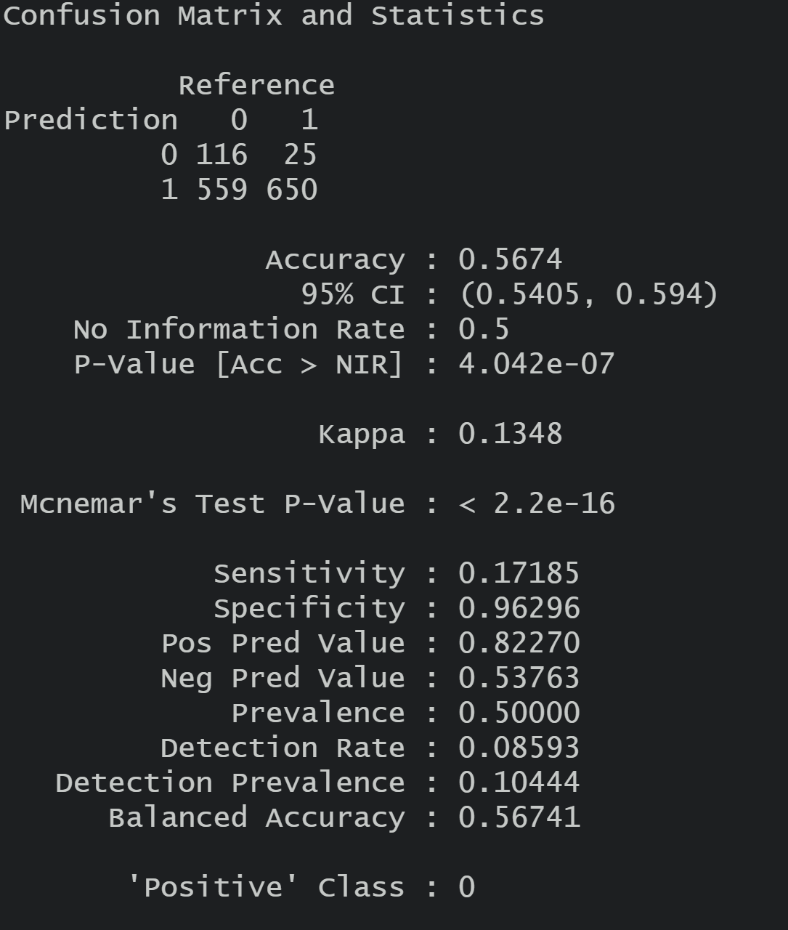
Naive Bayes
Accuracy = 56.74%
Precision = 82.27%
Recall = 17.19%
Naive Bayes performs the worst because it is susceptible to Bayesian poisoning i.e. given the dependent variable the features are not independent.

Slide 17
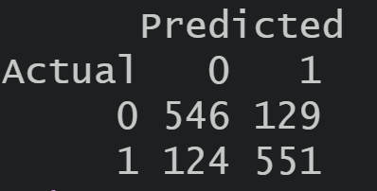
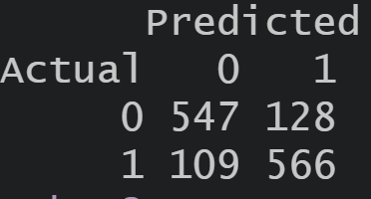
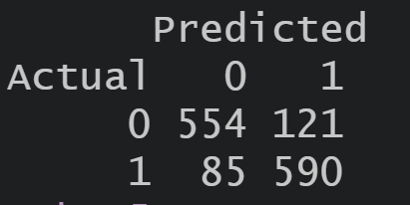
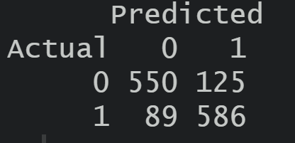
KNN
K=1; Error = 18.7%
K=2; Error = 17.5%
K=3; Error = 15.25%
K=2; Error = 15.85%

Slide 18
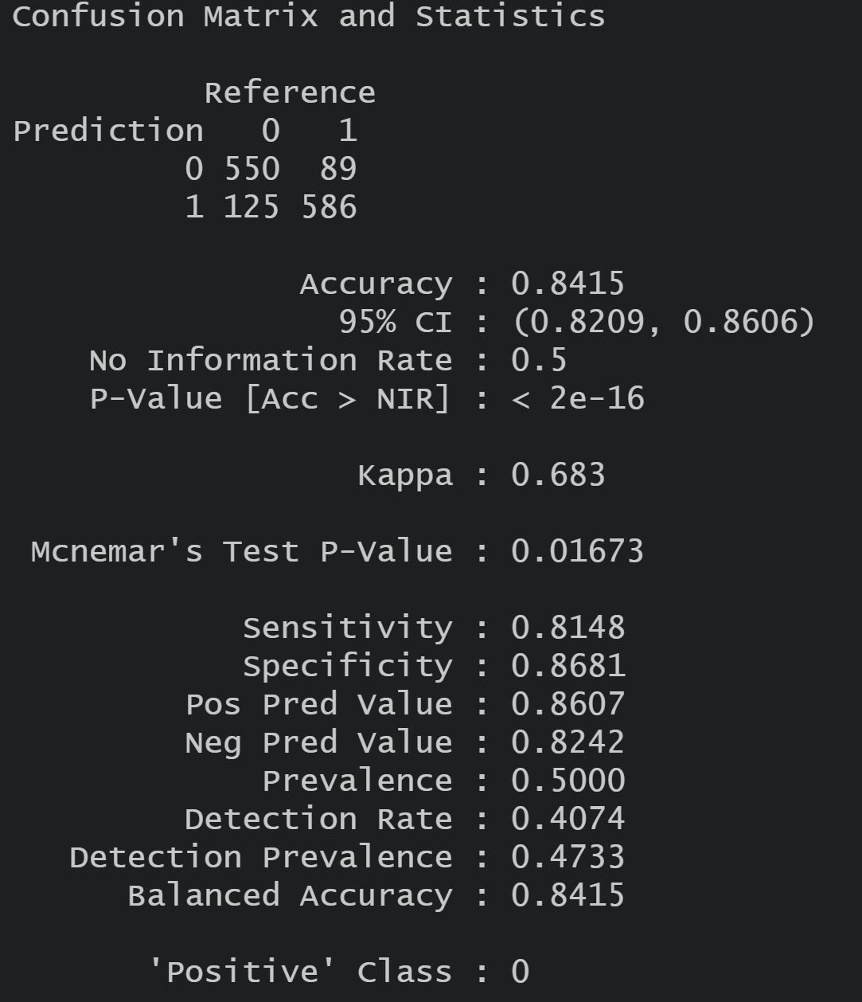
KNN(Contd…)
K = 5 performed the best
Accuracy = 84.15%
Precision = 86.07%
Recall = 81.48 %

Slide 19
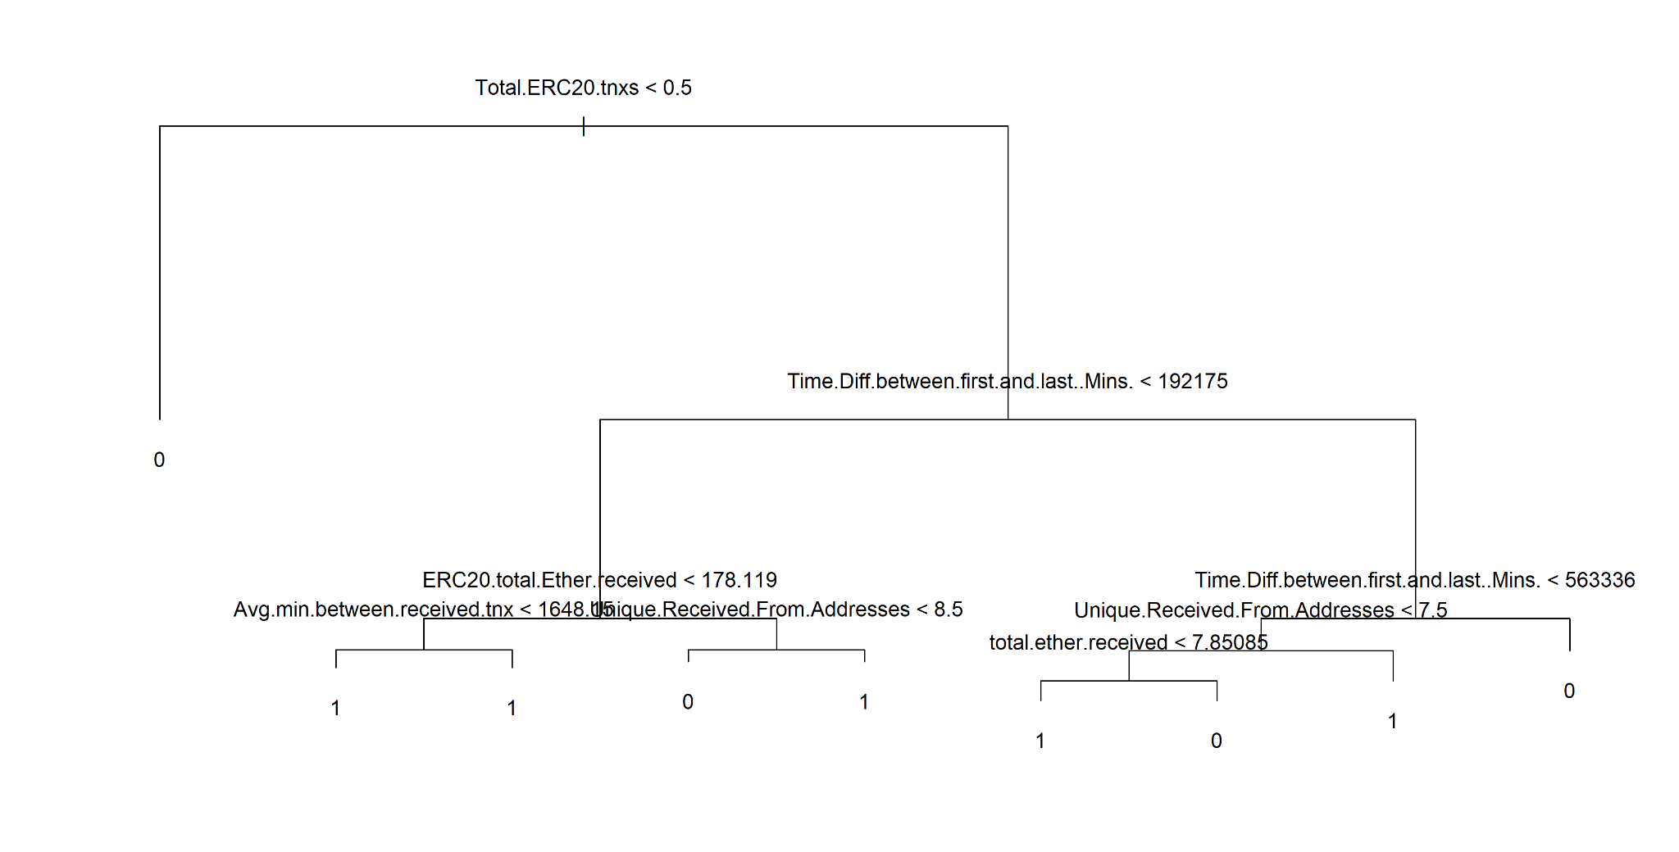
Classification Tree

Slide 20
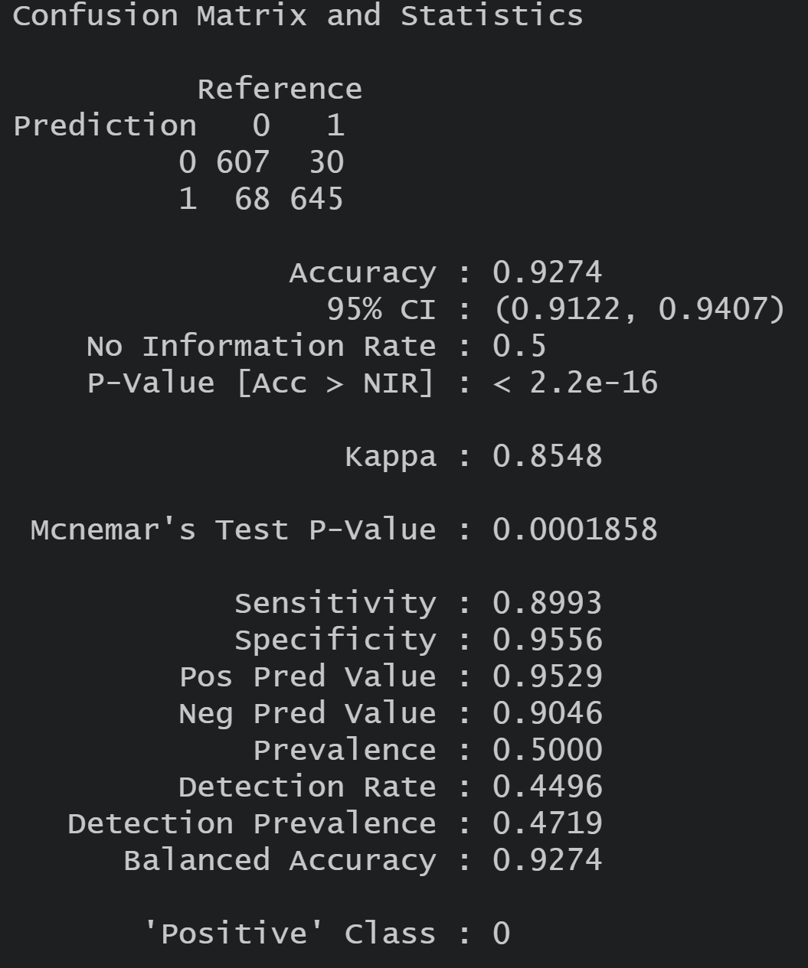
Classification Tree Results
Accuracy = 92.74%
Precision = 95.29%
Recall = 89.93%

Slide 21
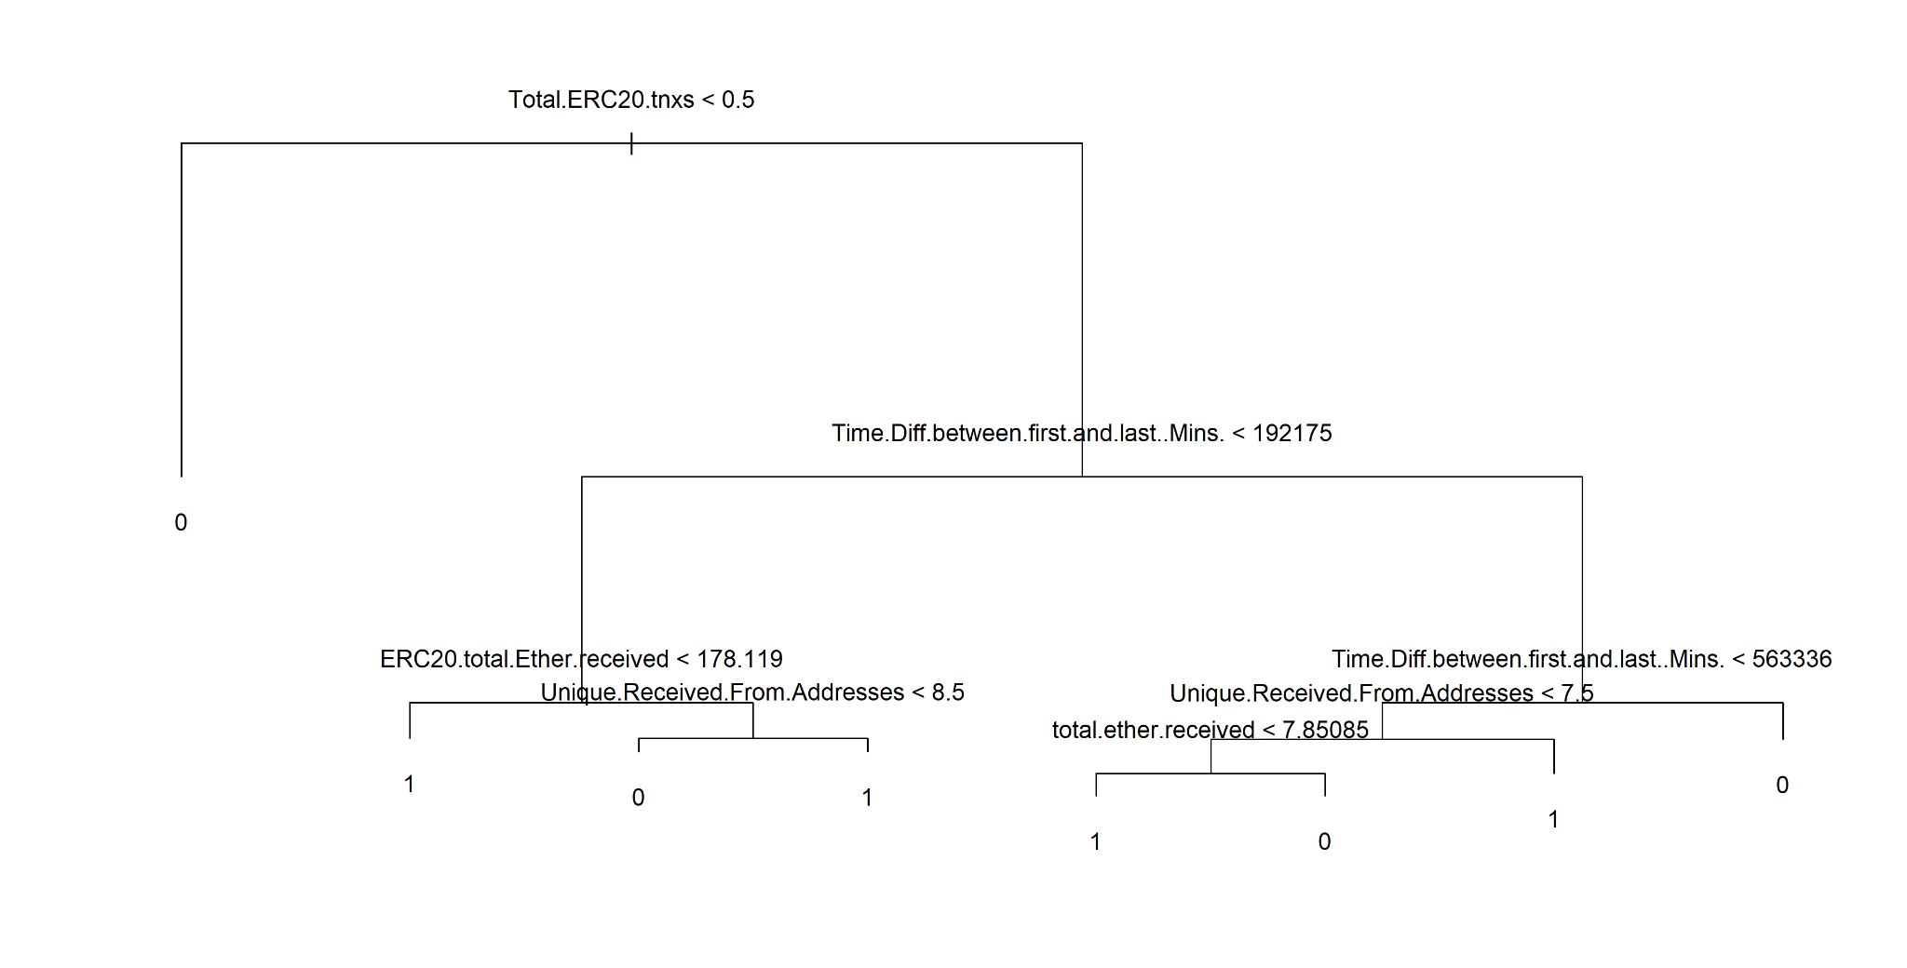
Pruned Classification Tree

Slide 22
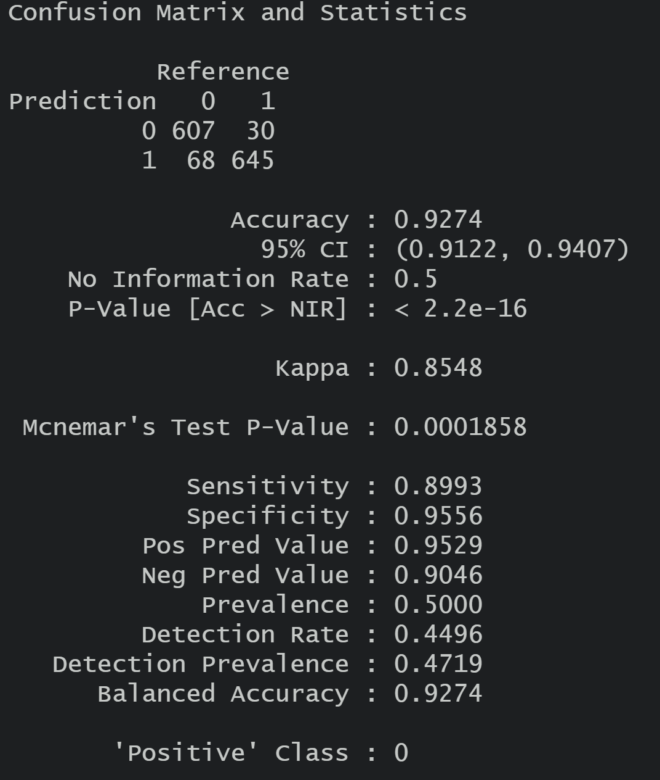
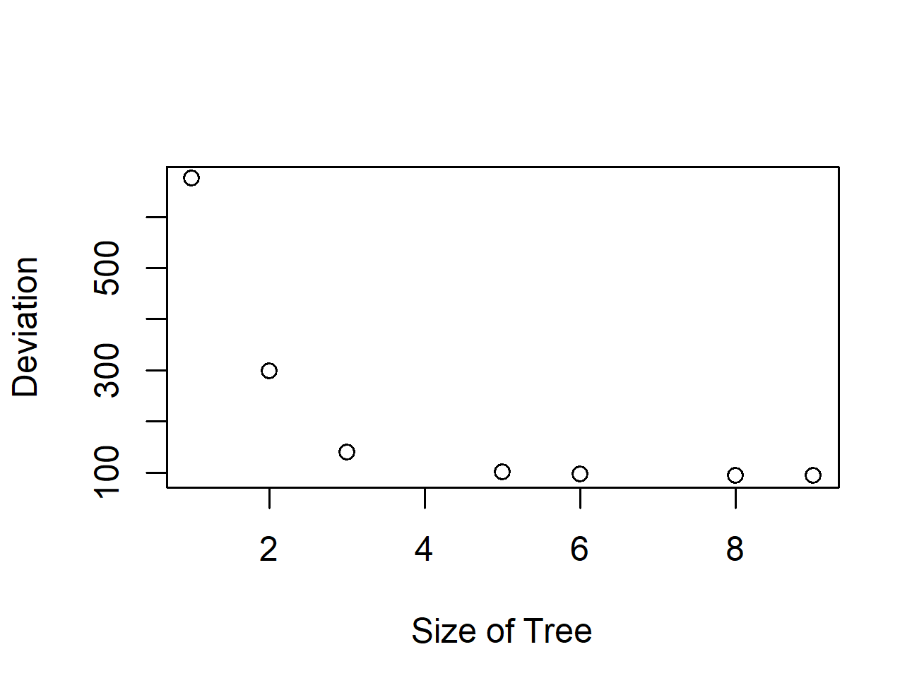
Pruned Classification Tree Results
Pruned the tree from 8 to 7
Accuracy = 92.74%
Precision = 95.29%
Recall = 89.93%

Slide 23
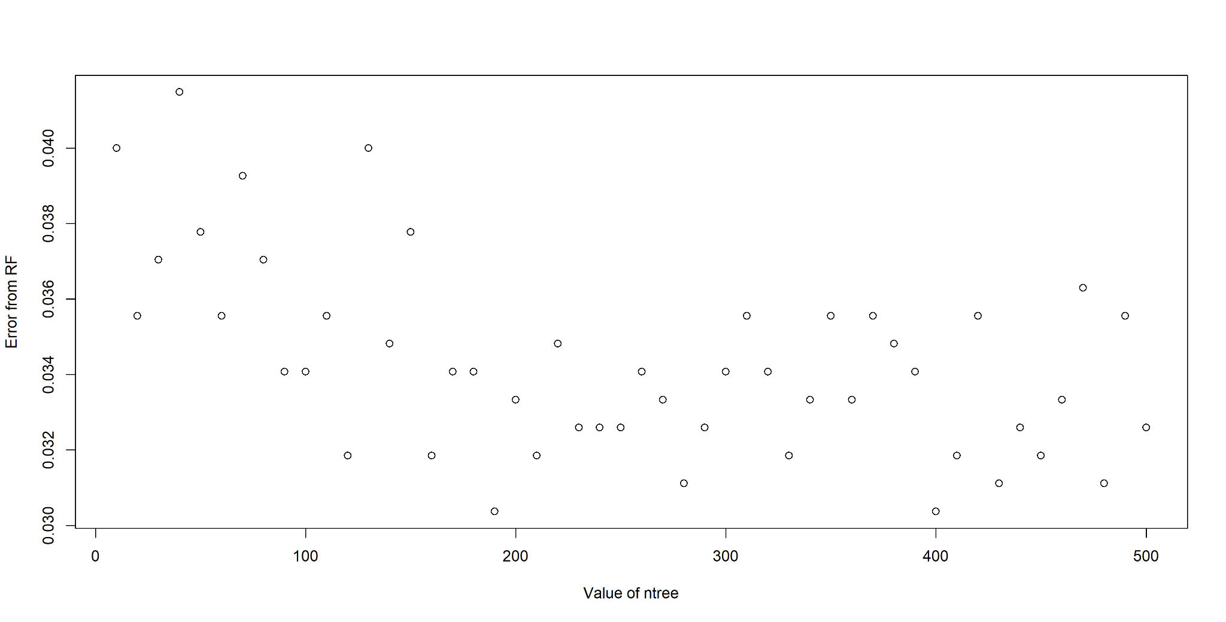
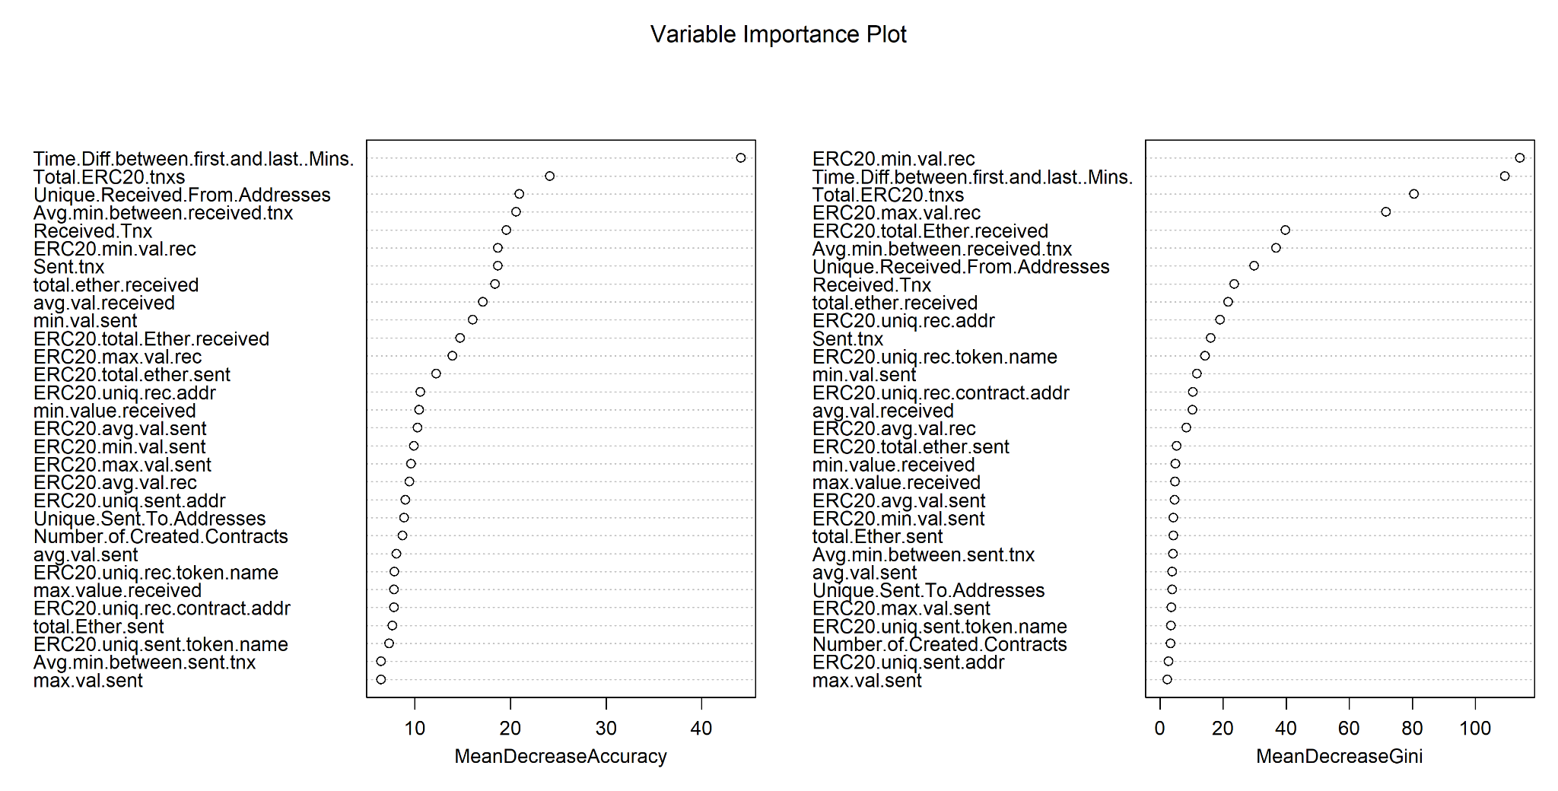
Random Forest
From the above graph, we can see that the optimal value for the hyperparameter ntree is 190 as it has the lowest error.

Slide 24
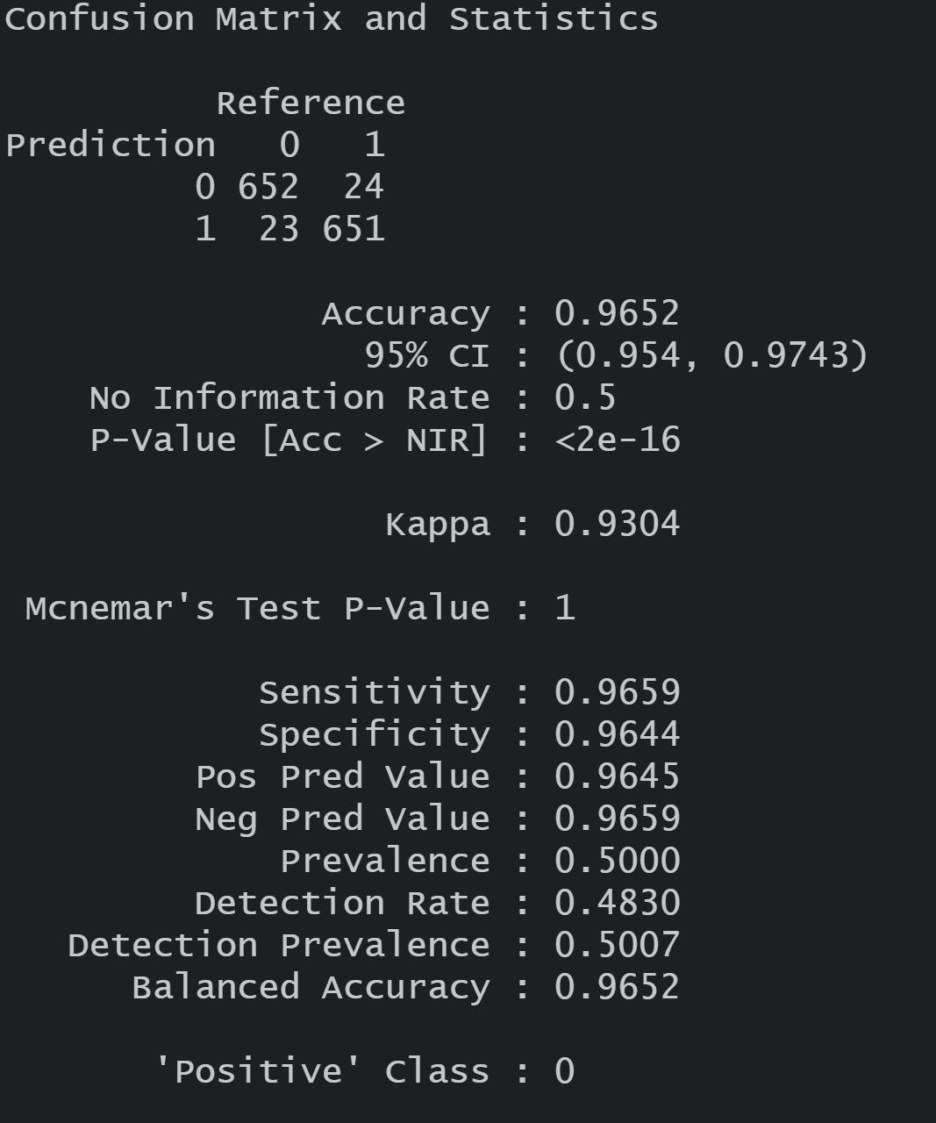
Random Forest Results
Accuracy = 96.52%
Precision = 96.45%
Recall = 96.44%

